Slide 1
SIT313 – Project Update
Sandas Dilina Koswattage Perera
ID - 216260121

Slide 2
WHATS IMPLEMENTED
As my project includes a calculator, currency converter and a unit converter, I have completed the calculator utility.

Slide 3
WHAT WORKED & DIDN’T
Getting the calculator to work was done without any problems.
Getting the layout to work properly was the difficulty I had to face

Slide 4
TIME SPENT & PLAN FOR NEXT WEEK
I took like three days to complete up to here and I am planning to finish all the coding by this week.

Slide 5
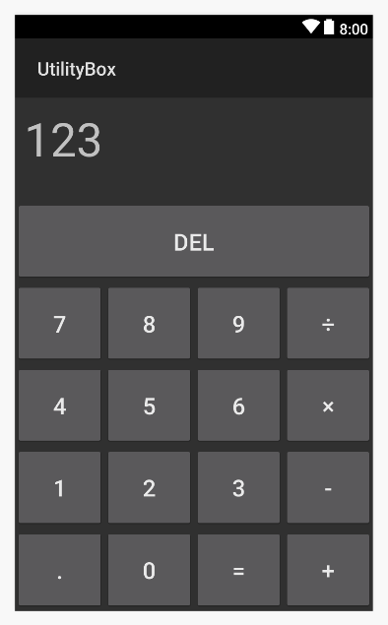
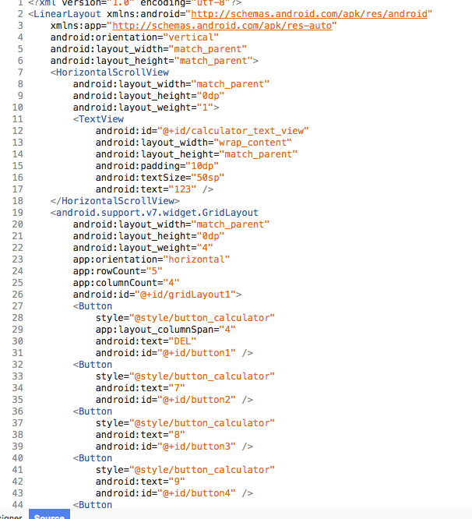
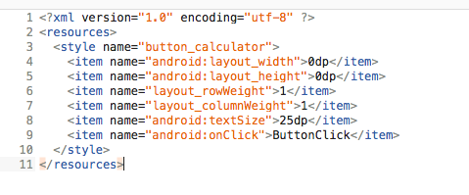
SCREENSHOTS

Slide 6
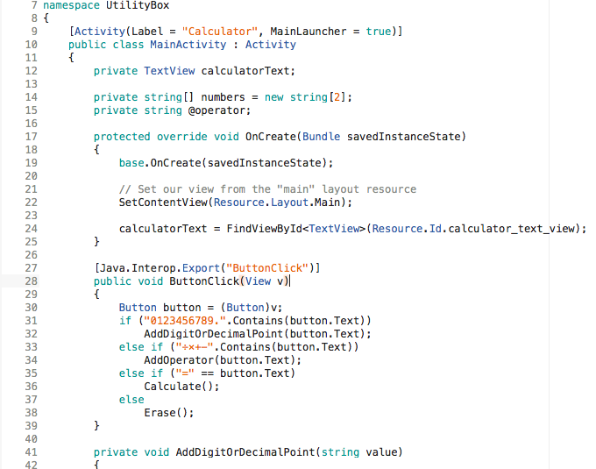
SCREENSHOTS

Slide 7
GITHUB LINK
https://github.com/dilina619/SIT313_Project1/blob/master/Project_Update.mp4
https://github.com/dilina619/SIT313_Project1

